Slide 1
Atomic Structure

Slide 2
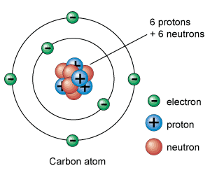
Subatomic Particles
Over the past century scientist have discovered that the atom is composed of 3 subatomic particles:
Protons
Neutrons
Electrons

Slide 3
Checking for understanding
Draw this diagram. Label all subatomic particles and include their charges.

Slide 4
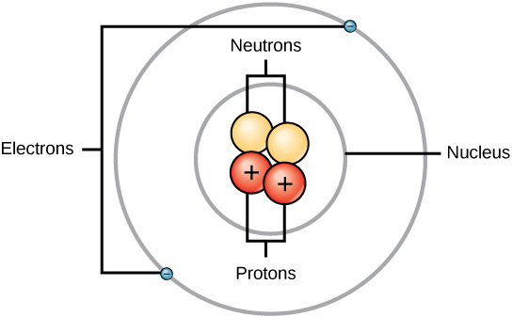
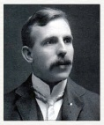
The Proton
Symbol = p+
Relative Mass = 1 Atomic Mass Unit (AMU).
Actual mass = 1.674 x 10 ⁻²⁴ g
Location: Inside the nucleus
5. Electrical charge: Positive.
6. Importance: The atomic number which is the identity of the element.
7. Discovered by: Ernest Rutherford in 1909

Slide 5
Real World Application - PROTON
The electron transport chain, which occurs in the membrane of mitochondria, uses a proton gradient to help produce ATP, a compound our body uses for energy.
Most acidic substances have more free protons (hydrogen ions) in them than hydroxide ions. Vinegar, lemon juice, and hydrochloric acid (HCl) are examples of acidic liquids.
pH is a measure of the number of free protons (hydrogen ions) in a solution. The pH scale ranges from 0-14, with 0 being acidic (more protons) and 14 being basic (fewer protons). pH measurements are widely used to determine the acidity of rain, bodies of water, and liquid waste from factories.
Proton therapy is also a new treatment for treat cancer. A beam of protons is directed towards a tumor and damages the tumor cells' DNA so they cannot reproduce.

Slide 6
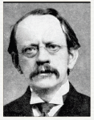
The Electron
Symbol = e-
Relative Mass = 1 /1836 Atomic Mass Unit.
Actual mass =
9.11 x 10 ⁻²⁸ g
4. Location: Energy level outside the nucleus
5. Electrical charge: Negative.
Importance: The number of electrons located in the last energy level determine the chemical activity of the element.
Discovered by: J.J.Thomson in 1897

Slide 7
Real World Application - Electron
Microscopes can be made by utilizing properties of electrons. One example is the scanning electron microscope (SEM). By sending a beam of electrons at the surface of an object, a SEM can make images of the surface with up to 500,000 times magnification. SEMs are commonly used to make high resolution images of dead cells, metal surfaces, and fossils.
The electron transport chain, which occurs in the membrane of mitochondria, uses proteins to catalyze reduction and oxidation reactions (reactions that exchange electrons between molecules) that produce ATP, a compound our body uses for energy.
Electrons moving through a metal wire produce electric current, or electricity.
All reduction and oxidation (redox) reactions occur by transferring electrons from one element, ion, or molecule to another. Examples of redox reactions include the formation of salt from elemental sodium and chlorine gas and the corrosion (rusting) of a iron nail in air.
Electrochemical cells and batteries produce energy by moving electrons from a cell with an oxidizing reaction to a cell with a reduction reaction.
Lasers work by pumping electrons into higher energy level orbitals. When the electrons fall back down into the lower energy orbital, they each release a photon, which we see as light.

Slide 8
The Neutron
Symbol = n
Relative Mass = 1 Atomic Mass Unit (AMU).
Actual mass =
1.675 x 10 ⁻²⁴ g
4. Location: Inside the nucleus
5. Electrical charge: Neutral.
6. Importance: Is responsible for isotopes (atoms of the same element with different numbers
of neutrons.
7. Discovered by: James Chadwick in 1932

Slide 9
Real World Application - Neutron
Neutron stars can be formed when stars use up all of their fuel. Protons and electrons in the star merge to form neutrons and neutrinos. The neutrons form the neutron star, which is usually around 20 km in diameter, but can be over twice the mass of the sun.
Nuclear fission reactions occur when a free neutron hits an atom's nucleus causing it to break apart into two different nuclei, thus forming two different atoms. Some elements, such as uranium-235, not only split into two different atoms when undergoing fission, but also release more neutrons. This allows for a chain reaction to occur as these neutrons go on to hit other uranium atoms and cause them to break apart as well. Nuclear power plants and nuclear weapons work by nuclear fission.
Neutrons are used in isotopic labeling, a process where atoms with a larger number of neutrons than usual are placed in a system and tracked to understand where they move in the system. One example of isotopic labeling is labeling atoms in pharmaceuticals to see where they end up in the body. This is a common use for deuterium, which is another stable form of hydrogen.
Different isotopes of elements (elements with different numbers of neutrons) are used to date objects. Carbon dating uses the ratio of carbon-14 to carbon-12 to determine the age of organic material up to 60,000 years old.

Slide 10
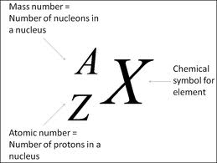
Atomic Number
Atomic number (Z) of an element is the number of protons in the nucleus of each atom of that element.
Element | # of protons | Atomic # (Z)
Carbon | 6 | 6
Phosphorus | 15 | 15
Gold | 79 | 79

Slide 11
Mass Number
Mass number is the number of protons and neutrons in the nucleus of an isotope.
Mass # = p⁺ + n⁰
Nuclide | p⁺ | n⁰ | e⁻ | Mass #
Oxygen - |  | 10
- | 33 | 42
- 31 | 15
18
8
8
18
Arsenic
75
33
75
Phosphorus
16
15
31

Slide 12
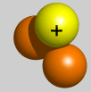
Isotopes
Isotopes are atoms of the same element having different masses due to varying numbers of neutrons.
Isotope | Protons | Electrons | Neutrons | Nucleus
Hydrogen–1 (protium) | 1 | 1 | 0
Hydrogen-2 (deuterium) | 1 | 1 | 1
Hydrogen-3 (tritium) | 1 | 1 | 2

Slide 13
Real World Application - ISOTOPES
Isotopes are used in a multitude of everyday objects. Smoke detectors, for instance, often contain a small amount of americium-241. One of the radioactive properties of this material allows for smoke to be detected at an extremely early stage.
Another rising use for radioactive isotopes is food irradiation. This is a process where food is exposed to the radiation of an element, often cobalt-60, though not in direct contact with it. With the high energy particles that are passing through the food, bacteria and microorganisms are killed. Cellular processes that lead to over-ripening and spoiling are also hindered.
Carbon, the main element in organic materials, has a variety of isotopes that are present in living organisms. By analyzing the abundances of these carbon molecules, paleontologists are able to discover the age of organic materials from bones to clothing.

Slide 14
Atomic Masses
Atomic mass is the average of all the naturally occurring isotopes of that element.
Isotope | Symbol | Composition of the nucleus | % in nature
Carbon-12 | ¹²C | 6 protons 6 neutrons | 98.89%
Carbon-13 | ¹³C | 6 protons 7 neutrons | 1.11%
Carbon-14 | ¹⁴C | 6 protons 8 neutrons | <0.01%
Carbon = 12.011

Slide 15
Weight Average Atomic Mass
The atomic masses given on the periodic table are WEIGHT-AVERAGED masses.
This is calculated using both the masses of each isotope and their percent abundances in nature.
For the purposes of simplicity, we will round weight-average mass to the THOUSANDTHS place.
The weight-average mass is based on the abundance of the naturally occurring isotopes of that element

Slide 16
Weight Average Atomic Mass
To find the weight-average mass of an element given the mass of each isotope and each isotopes percent abundance:
WAM =
(massisotope 1 X % ) + (massisotope 2 X % ) + (massisotope 3 X % ) + etc…

Slide 17
Atomic Mass Unit (AMU)
amu = atomic mass unit
the ratio of the average mass per atom of the element to 1/12 of the mass of 12C in its nuclear and electronic ground state.
An atomic mass unit is actually an average mass, found by taking the mass of a C-12 nucleus and dividing it by 12
Hydrogen = 1amu, 1/12 of C

Slide 18
Carbon has two stable isotopes
Carbon-12 has natural abundance of 98.89% and 12.000 amu
Carbon-13 has natural abundance of 1.11% and 13.003 amu
Calculate the atomic mass
Givens
Carbon-12 m=12.000 amu Abundance= 98.89%=0.9889
Carbon-13 m = 13.003 amu Abundance = 1.11%=0.0111
Formula
atomic mass of carbon-avg
= (mass C-12 x nat.abund) + (mass C-13 x nat.abund.)
Plug in the #s
(12.000amu x 0.9889) + (13.003 amu x 0.0111)
= 12.011 amu
= 12.0 amu

